Slide 1


TEAM “CODEPROS”

Slide 2

A little about the project…
What are we looking at and why ?
Name : “WhereMy€Went”

Slide 3
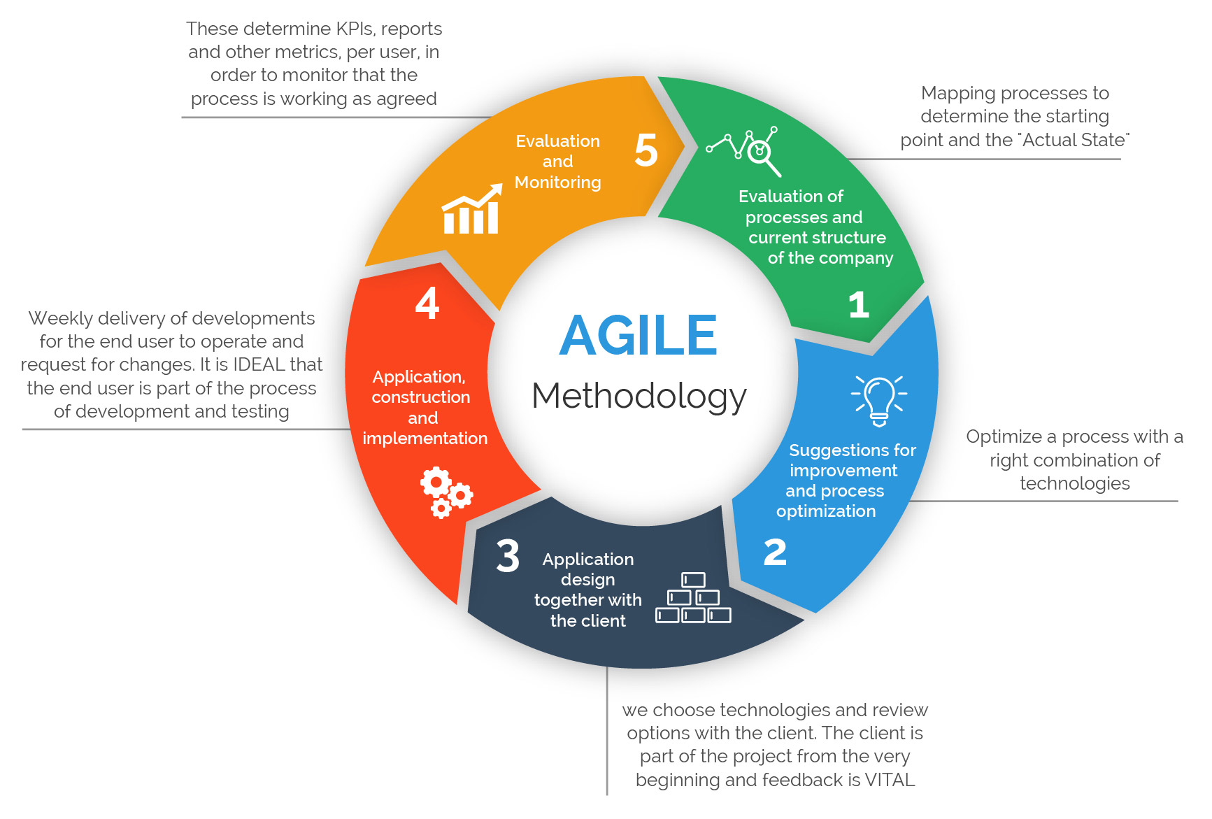
Methodology : Agile (Scrum).

Slide 4
Team Communication :
- Skype and WhatsApp group.
Weekly status meetings.
Daily short standup meetings (If needed).
Repository:
- GitHub for code.
Google Drive for Documents and other stuff.

Slide 5
Documentation :
They say “Project will never be considered complete until documentation is completed ”
Functional Document.
Technical Design Document.
Challenges encountered Document.

Slide 6

Roles and Responsibilities:
Roles and Responsibilities:
-Specific roles as per interests.
-Peer to peer monitoring.
-Specific roles as per interests.
-Peer to peer monitoring.

Slide 7

Let’s talk about the team :

Slide 8
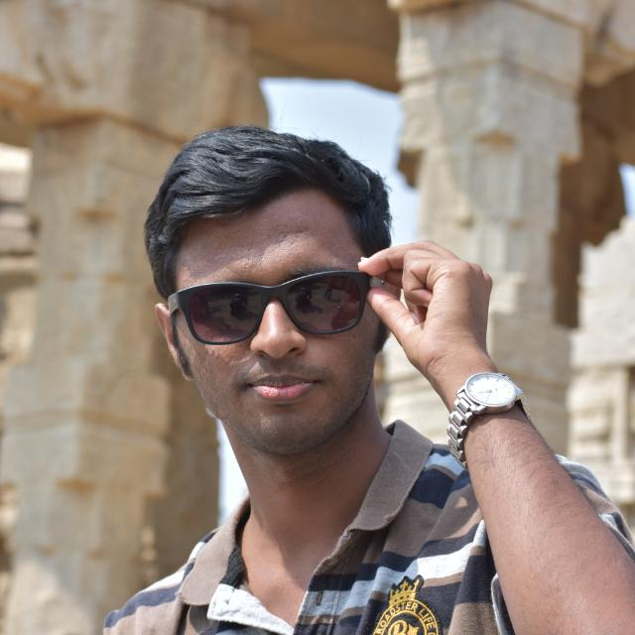
Shantharam Suhas :
He is interested in this course as he would get to work with new software, improve his programming skills and also help solve real world problems with the help of an application .It will also provide him the opportunity to collaborate with different people and get to know what it means to work in a team environment.

Slide 9

Okafor Chigozie Kenneth :
He stands to gain much from the principle of software engineering. It will help in polishing his skill in coding and help him in using structured approaches in problem solving. he looks forward to working with people from diverse backgrounds and expertise.

Slide 10

Nazar Iqa Warraich :
He is interested in this subject as it will help in developing programming skill and to learn the principles of software engineering. Furthermore, to work with people with different skill sets will enhance teams skills.

Slide 11
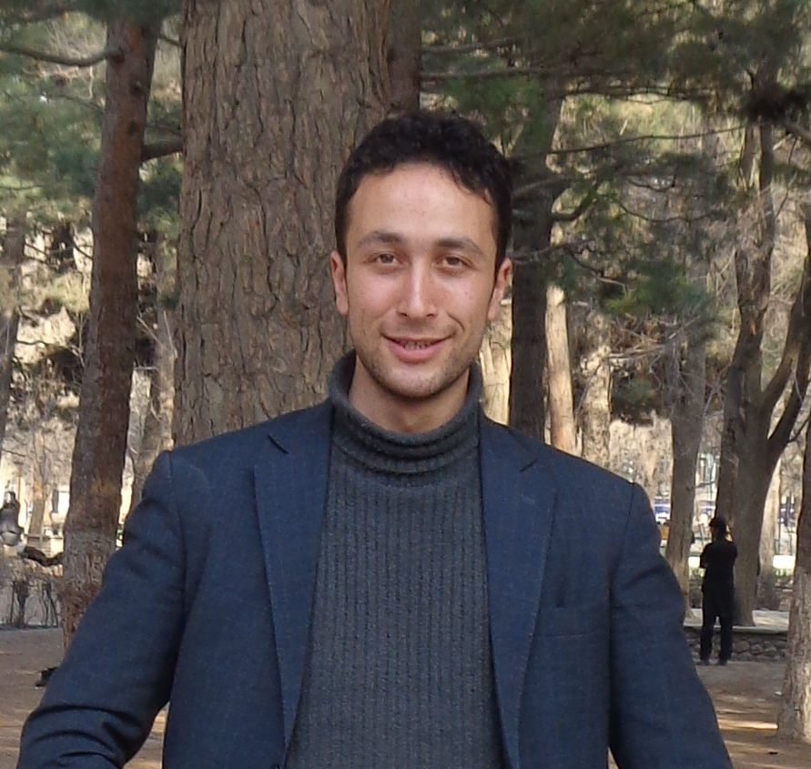
Saied Akbar Ahmady :
It's fun for him to take part in a team for making a useful application by merging pieces of codes together.

Slide 12
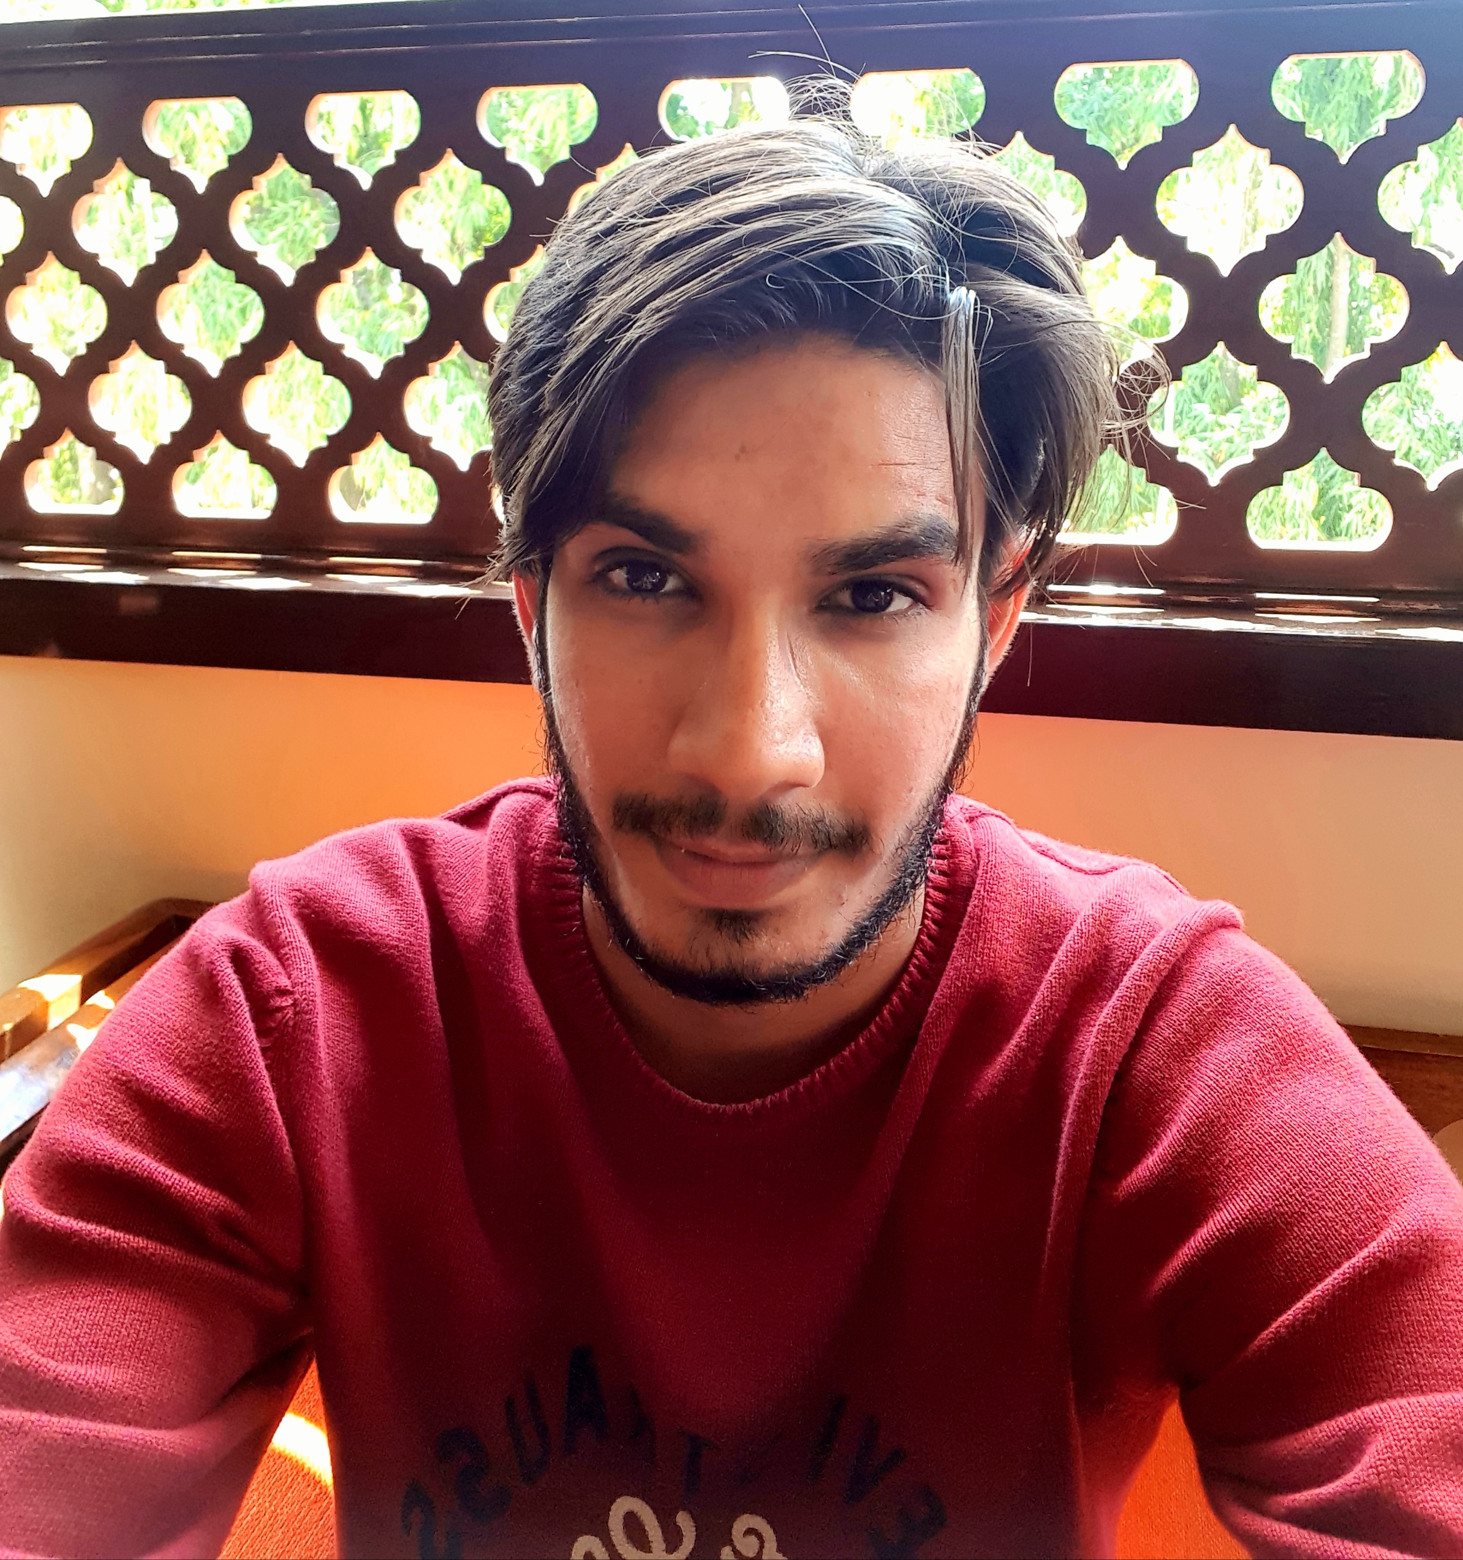
Amit Kumar :
I am come from corporate software development background where we have developed and deployed software for enterprise use. Hence it will be exciting to be part of project which target single human being as a end user. Also , will be privileged to learn new skill such as : Android studio , Java etc.

Slide 13


